Slide 1

INTRODUCTION TO CYBER SECURITY.
PAGE 1

Slide 2
Course Outline
What is cyber security.
Cyber security goals.
Why do we need cybersecurity?
Factors influencing cyber-crime.
The impact of cybercrime.

Slide 3
Course Outline
Examples of cybercrime.
Threat actor groups
Cybercrime prevention.
Cyber ethics and laws
Summary

Slide 4
Learners will be able to:
Recognize cyber security's importance in the increasingly computer-driven world.
Master the key concepts of cyber security and how they work.
Explain the technology principles of security detection/protection and access control.
Describe and comply with relevant industry and organizational codes of conduct.
Describe cybersecurity related roles and responsibilities.
PAGE 4

Slide 5
Learners will be able to:
Know how to manage cyber security policies.
Distinguish between the major categories of computer crime.
Create policies related to cyber security policy and governance
PAGE 5

Slide 6
FACTS !
The global cost of cybercrime is expected to exceed $2 trillion in 2022.
There are ransomware attacks every 14 seconds.
The main cause of data breaches are malicious or criminal attacks, and they are responsible for 48 percent of all data breaches.
Phishing emails are responsible for about 91 percent of cyber-attacks.
Half of all cyber-attacks are targeted at small businesses.

Slide 7
WHAT IS CYBERSECURITY?
Cyber security is the mission focused and risk optimized governance of information, which maximizes confidentiality, integrity and availability using a balanced mix of people, policy and technology while perennially improving over time.
"Cybersecurity is much more than an IT topic.” Stephane Nappo

Slide 8

CYBER SECURITY GOALS.
What do cybersecurity try to accomplish?
Cyber security’s objectives are often defined using the CIA triad as a good starting point.
CIA is a mnemonic for the three objectives:
Confidentiality,
Integrity,
Availability.

Slide 9
CYBER SECURITY GOALS CONT…
CONFIDENTIALITY
Let's look at some examples to put the cyber security objectives into context.
Confidentiality may be the most important objective for government intelligence agencies.
Think about the lengths they go to in order to keep information private, such as using bespoke encryption or even lead-lined brief cases that sink if thrown into a body of water.

Slide 10
CYBER SECURITY GOALS CONT…
Integrity
Let's look at some examples to put the cyber security objectives into context.
Integrity may be the most important objective for banks.
Think about if you spent USD $10 on a pizza. You would not be particularly concerned about this transaction being confidential. However, if the transaction is altered and you end up spending USD $10,000 instead, then you would be in serious financial trouble. Should this happen at scale for your bank, it could cease operating as a result of a loss of trust.

Slide 11
CYBER SECURITY GOALS CONT…
AVAILABILITY
Let's look at some examples to put the cyber security objectives into context.
Availability may be the most important objective for a website.
Think about if you have a blog. You would not be particularly concerned if it was confidential or an editor helps correct your spelling. You want it to be there and available to you any time you want to update and publish it.

Slide 12
CYBER SECURITY GOALS CONT…
Let's look at the cyber security objectives/ goals.

Slide 13

CYBER SECURITY GOALS CONT…
CONFIDENTIALITY.

Slide 14
CYBER SECURITY GOALS CONT…
CONFIDENTIALITY
What is Confidentiality?
Confidentiality means preventing information from falling into the hands of people who do not have authorization to access the information.

Slide 15
CYBER SECURITY GOALS CONT…
CONFIDENTIALITY
What is Confidentiality?
It is roughly equivalent to privacy and avoids the unauthorized disclosure of information.
It involves the protection of data, providing access for those who are allowed to see it while disallowing others from learning anything about its content.
It prevents essential information from reaching the wrong people while making sure that the right people can get it.

Slide 16
CYBER SECURITY GOALS CONT…
CONFIDENTIALITY
Confidentiality.
What is the thought of your private health information or financial information falling into some stranger’s hands?
What is the thought of a business owner whose proprietary business information being disclosed to competitors?
NB: Information is valuable.

Slide 17
CYBER SECURITY GOALS CONT…
CONFIDENTIALITY
How is Confidentiality achieved?
It can be achieved through deploying:
Encryption
Access control
Authentication
Authorization
Physical security

Slide 18
CYBER SECURITY GOALS CONT…
CONFIDENTIALITY
How is Confidentiality achieved?
Encryption.
Encryption is a method of transforming information to make it unreadable for unauthorized users by using an algorithm.
The transformation of data uses a secret key (an encryption key) so that the transformed data can only be read by using another secret key (decryption key).

Slide 19
CYBER SECURITY GOALS CONT…
CONFIDENTIALITY
How is Confidentiality achieved?
Access control
Access control defines rules and policies for limiting access to a system or to physical or virtual resources.
It is a process by which users are granted access and certain privileges to systems, resources or information.

Slide 20
CYBER SECURITY GOALS CONT…
CONFIDENTIALITY
How is Confidentiality achieved?
Access control
In access control systems, users need to present credentials before they can be granted access such as:
a person's name
a computer's serial number.

Slide 21
CYBER SECURITY GOALS CONT…
CONFIDENTIALITY
How is Confidentiality achieved?
Authentication
Authentication is the process that ensures and confirms a user's identity or role that someone has.

Slide 22
CYBER SECURITY GOALS CONT…
CONFIDENTIALITY
How is Confidentiality achieved?
Authentication
It can be done in a number of different ways, but it is usually based on a combination of:
something the person has
something the person knows
something the person is

Slide 23
CYBER SECURITY GOALS CONT…
CONFIDENTIALITY
How is Confidentiality achieved?
Authentication
Authentication is the necessity of every organization since it enables organizations to keep their networks secure by permitting only authenticated users to access its protected resources.
These resources may include:
computer systems
Networks
Databases
Websites
other network-based applications or services.

Slide 24
CYBER SECURITY GOALS CONT…
CONFIDENTIALITY
How is Confidentiality achieved?
Authorization.
Authorization is a security mechanism which gives permission to do or have something.
It is used to what determine a person or system is allowed access to resources, based on:
an access control policy,
computer programs,
files,
services,
Data,

Slide 25
CYBER SECURITY GOALS CONT…
CONFIDENTIALITY
How is Confidentiality achieved?
Authorization.
It is normally preceded by authentication for user identity verification.
During authorization, a system verifies an authenticated user's access rules and either grants or refuses resource access.

Slide 26
CYBER SECURITY GOALS CONT…
CONFIDENTIALITY
How is Confidentiality achieved?
Physical security
Physical security describes measures designed to deny the unauthorized access of IT assets like:
Facilities,
Equipment,
Personnel,
resources and other properties from damage.
It protects these assets from physical threats including theft, vandalism, fire and natural disasters.

Slide 27

CYBER SECURITY GOALS CONT…
INTEGRITY.

Slide 28
CYBER SECURITY GOALS CONT…
INTEGRITY.
What is integrity?
Integrity means making sure the information stays accurate, consistent, and ensuring that unauthorized people cannot makes any changes to the information.

Slide 29
CYBER SECURITY GOALS CONT…
INTEGRITY.
What is integrity?
Integrity is the protection of information, processes, or systems from intentional or accidental unauthorized modification.
Integrity refers to the methods for ensuring that data is real, accurate and safeguarded from unauthorized user modification.

Slide 30
CYBER SECURITY GOALS CONT…
INTEGRITY.
What is integrity?
Data integrity is a requirement that information and programs are changed only in a specified and authorized manner.
System integrity is a requirement that a system performs its intended function in an unimpaired manner, free from deliberate or inadvertent unauthorized manipulation of the system.

Slide 31
CYBER SECURITY GOALS CONT…
INTEGRITY.
How is integrity achieved?
Integrity can be achieved through the following:
Validate Input
Validate Data
Remove Duplicate Data
Back up Data
Access Controls
Always Keep an Audit Trail
Checksums

Slide 32
CYBER SECURITY GOALS CONT…
INTEGRITY.
How is integrity achieved?
Validate Input:
When your data set is supplied by a known or unknown source (an end-user, another application, a malicious user, or any number of other sources) you should require input validation. That data should be verified and validated to ensure that the input is accurate.

Slide 33
CYBER SECURITY GOALS CONT…
INTEGRITY.
How is integrity achieved?
Validate Data:
It’s critical to certify that your data processes haven’t been corrupted. Identify specifications and key attributes that are important to your organization before you validate the data.

Slide 34
CYBER SECURITY GOALS CONT…
INTEGRITY.
How is integrity achieved?
Remove Duplicate Data:
Sensitive data from a secure database can easily find a home on a document, spreadsheet, email, or in shared folders where employees without proper access can see it. It’s prudent to clean up stray data and remove duplicates.

Slide 35
CYBER SECURITY GOALS CONT…
INTEGRITY.
How is integrity achieved?
Back up Data:
Backing up is necessary and goes a long way to prevent permanent data loss. How often should you be backing up? As often as possible.
Keep in mind that backups are critical when organizations get hit with ransomware attacks. Just make sure that your backups aren’t also encrypted!

Slide 36
CYBER SECURITY GOALS CONT…
INTEGRITY.
How is integrity achieved?
Access Controls:
Individuals within an organization without proper access and with malicious intent can do grave harm to the data. What’s worse, an outsider impersonating an insider can also be detrimental.
Implementing a least privilege model – where only users who need access to data get access – is a very successful form of access control.

Slide 37
CYBER SECURITY GOALS CONT…
INTEGRITY.
How is integrity achieved?
Always Keep an Audit Trail:
Whenever there is a breach, it’s critical to data integrity to be able to track down the source. This provides an organization the breadcrumbs to accurately pin point the source of the problem.

Slide 38
CYBER SECURITY GOALS CONT…
INTEGRITY.
How is integrity achieved?
Checksums.
A checksum is a numerical value used to verify the integrity of a file or a data transfer.
It is the computation of a function that maps the contents of a file to a numerical value.
They are typically used to compare two sets of data to make sure that they are the same.

Slide 39

CYBER SECURITY GOALS CONT…
AVAILABILITY.

Slide 40
CYBER SECURITY GOALS CONT…
AVAILABILITY.
What is availability.
Availability means timely and reliable access to and use of the information when required.
Availability is the assurance that systems and data are accessible by authorized users when needed.

Slide 41
CYBER SECURITY GOALS CONT…
AVAILABILITY.
What is availability.
It is the guarantee of reliable and constant access to our sensitive data by authorized people.
NB: If we can’t access the data we need, when we need it, we are not secure.

Slide 42
CYBER SECURITY GOALS CONT…
AVAILABILITY.
How is availability achieved?
Availability can be achieved through the following:
Backup
Backing up is necessary and goes a long way to prevent permanent data loss. How often should you be backing up? As often as possible.
Keep in mind that backups are critical when organizations get hit with ransomware attacks.

Slide 43
CYBER SECURITY GOALS CONT…
AVAILABILITY.
How is availability achieved?
Availability can be achieved through the following:
Computational redundancy
It is applied as fault tolerant against accidental faults.
It protects computers and storage devices that serve as fallbacks in the case of failures.

Slide 44
CYBER SECURITY GOALS CONT…
AVAILABILITY.
How is availability achieved?
Availability can be achieved through the following:
Physical protection
Physical safeguard means to keep information available even in the event of physical challenges.
It ensure sensitive information and critical information technology are housed in secure areas.

Slide 45
CYBER SECURITY GOALS CONT…
In order to achieve this objectives there are key elements of cyber security that must be considered.

Slide 46
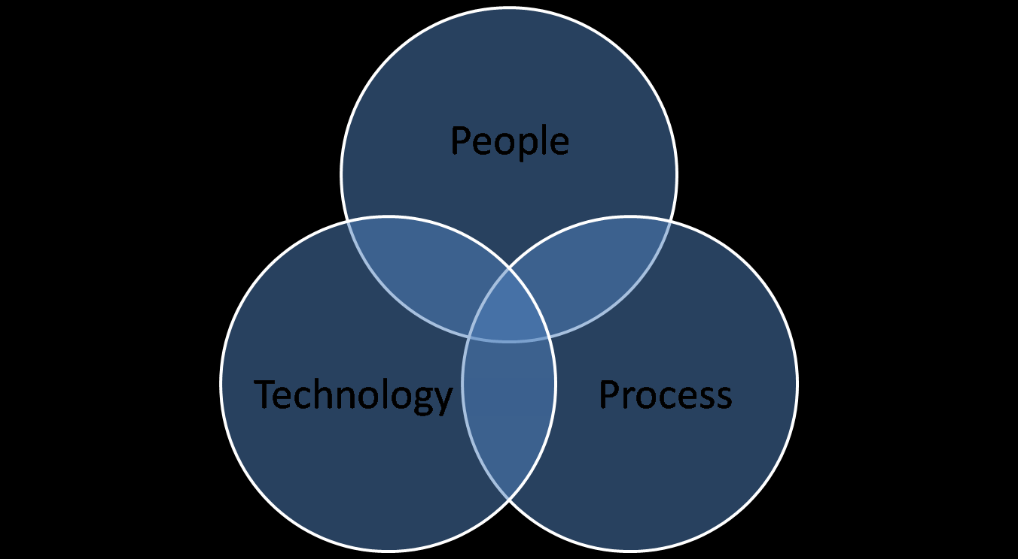
key elements of cybersecurity

Slide 47
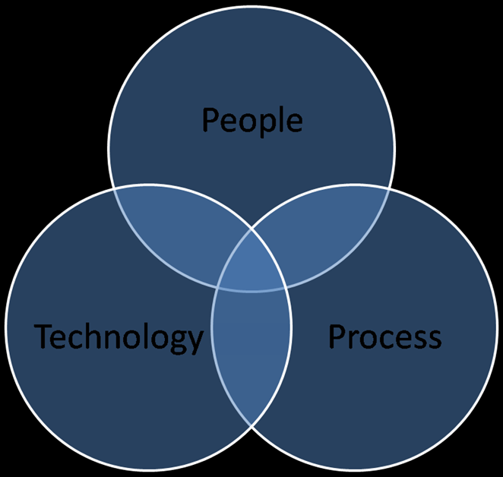
key elements of cybersecurity
These are the areas where an attacker could attack and where organizations should focus cybersecurity efforts. Let's examine them further.

Slide 48
key elements of cybersecurity cont…
People
As counter intuitive as it might be for a highly digital industry, people are the most important part of cybersecurity.
People are the end users of digital systems and are often those responsible for the design and maintenance of digital systems.
Human action is by far the leading cause of cybersecurity incidents. When organizations design a secure system, they must design with people in mind.

Slide 49
key elements of cybersecurity cont…
People
A common example of this going wrong is the case of alert fatigue. If people receive too many notifications or alarms, then they eventually become desensitized to it.
Good systems will be designed to anticipate and make allowances for human behavior.

Slide 50
key elements of cybersecurity cont…
Process
In business, most activities follow a clearly defined set of steps. These processes can aid cybersecurity by considering security at each step or hinder cybersecurity by being frustrating for the end user.
Imagine a process which makes a user complete a 20-question survey whenever they wish to report suspicious activity. Many users, who could contribute useful information, might be deterred and give up the process.

Slide 51
key elements of cybersecurity cont…
Process
Good processes have the following attributes:
They are clear and as easy as possible.
They are accessible or well known.
They are consistent.

Slide 52
key elements of cybersecurity cont…
Technology
Technology is all of the underlying infrastructure.
Within cybersecurity, this commonly covers elements such as device encryption, network perimeter defenses, and anti-malware technologies.
Within business, good uses of technology solve problems without creating new ones for their users.

Slide 53
key elements of cybersecurity cont…
Technology
The following table shows some technological leaps for security, their perceived drawbacks, and some downsides to their introduction from the user perspective.
Technological leap | Business benefit | Perceived drawback | Undesirable user responses
Automated patch management | All software is up-to-date | Interruptions to use of device | User does not power down devices
High complexity mandatory passwords | Harder for attackers to guess passwords | Tedious to use | P@ssw0rd!
Mandatory passwords expire after 30 days | Passwords cannot be compromised for long periods of time | Predictably repetitive | PasswordJan to then PasswordFeb
Encrypted emails | Attackers cannot read emails in transit | Additional configuration and complexity | Disable encryption feature

Slide 54
key elements of cybersecurity cont…
Technology
An example of good technical security is device management software, which can track software patch statuses and apply updates. This is often an essential tool for large organizations. If this is done correctly, then the technology is non-intrusive and users will be secured in a passive manner. If this is done poorly, then users might try to disable the software entirely. As users of devices, you encounter this too.

Slide 55
key elements of cybersecurity
This elements have to be in sync so as to achieve cyber security. Putting weight on one or two elements will not have a major impact.

Slide 56
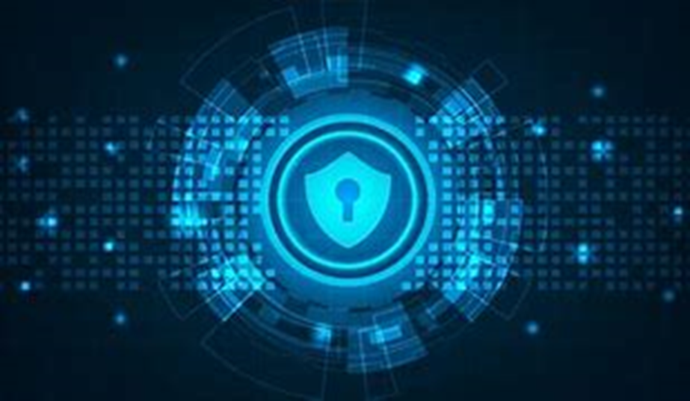
WHY DO WE NEED CYBERSECURITY?
“There are only two kinds of companies: those that have been hacked, and those that will be.”

Slide 57
WHY DO WE NEED CYBERSECURITY?
With the number of cybersecurity threats growing in a big way, more and more answers are emerging to the question, “Why is cybersecurity important?” and Businesses need to respond to these threats by adopting strict security measures.

Slide 58
WHY DO WE NEED CYBERSECURITY? Cont…
Currently organized cybercrimes far out shadow lone hackers of the past now organized crime rings function like start-ups and often employ highly-trained developers who are constantly innovating online attacks.
With so much data to exploit out there, Cybersecurity has become critical.

Slide 59
WHY DO WE NEED CYBERSECURITY? Cont…
The increasing reliance of our information-age economies and governments on cyber infrastructure makes them progressively more vulnerable to cyber-attacks on our computer systems, networks, and data.

Slide 60
WHY DO WE NEED CYBERSECURITY? Cont…
In their most disruptive form, cyber-attacks target the enterprise, government, military, or other infrastructural assets of a nation or its citizens.

Slide 61

FACTORS INFLUENCING CYBER-CRIME.

Slide 62
FACTORS INFLUENCING CYBER-CRIME.
Cybercrime is a malevolence, which is growing with the increase in our reliance with computers in modern day to day life.
In our today’s life when anything from kitchen to nuclear power plants is being run by computers. That’s why cybercrime has become so common everywhere in our life.

Slide 63
FACTORS INFLUENCING CYBER-CRIME cont…
Cybercrime is influenced by various factors such as:
Cybercriminals adapting diversity.
Pushing threats to the supply chain.
Vulnerabilities demand costly solutions.
Compromising geopolitics.
Hybrid motives.

Slide 64
FACTORS INFLUENCING CYBER-CRIME cont…
Cybercrime is influenced by various factors such as:
Cybercriminals adapting diversity.
Criminals working in groups or operating as legit start-ups.
Pushing threats to the supply chain.
Targeting third party providers on the supply chain.

Slide 65
FACTORS INFLUENCING CYBER-CRIME cont…
Cybercrime is influenced by various factors such as:
Vulnerabilities demand costly solutions.
License upgrades or solutions maybe “expensive”.
Compromising geopolitics.
Laws on different jurisdiction may be vary.
Hybrid motives.
Insider threats.

Slide 66
FACTORS INFLUENCING CYBER-CRIME cont…
Cyber criminals take advantage of these factors to target an organization.

Slide 67
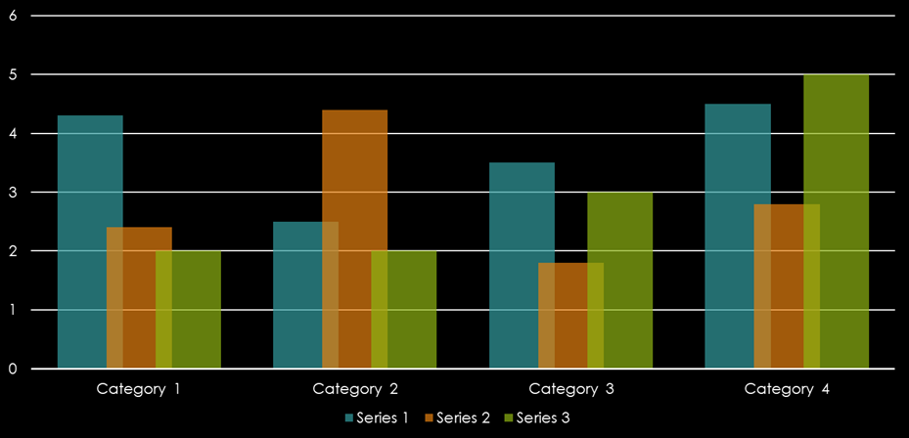
THE IMPACT OF CYBERCRIME

Slide 68
THE IMPACT OF CYBERCRIME.
It is difficult to accurately assess the actual impact of cybercrime.
The impact of cybercrime can be devastating due to the high risk of data loss and financial impact.

Slide 69
THE IMPACT OF CYBERCRIME cont…
The effects of cybercrime can be classified into the following three categories:
For Individuals
For Businesses
For Government

Slide 70
THE IMPACT OF CYBERCRIME cont…
For Individuals
The impact of cybercrime can be mostly seen on individuals. There can be issues like data breaches, identity theft, or trafficking to malicious sites, etc. with the devices.

Slide 71
THE IMPACT OF CYBERCRIME cont…
For Individuals
One may see suspicious charges on credit cards and loose access to their financial accounts. Additionally, cybercriminals may misuse data stored on devices for harassment and blackmailing.

Slide 72
THE IMPACT OF CYBERCRIME cont…
For Businesses
Businesses may suffer from sensitive data loss, financial loss, or brand damage, etc. It can directly affect the value of a company, the share price, and can also cause loss of reputation, customers, etc.

Slide 73
THE IMPACT OF CYBERCRIME cont…
For Businesses
If companies fail to protect customer data, they will also have to pay fines and penalties. In addition, a cybercriminal may secretly sell the company's sensitive data to other companies.

Slide 74
THE IMPACT OF CYBERCRIME cont…
Cyber-security researchers have identified different ways in which cyber-attacks can have a negative impact on individuals, businesses and even nations, ranging from threats to life, causing depression, regulatory fines or disrupting daily activities

Slide 75
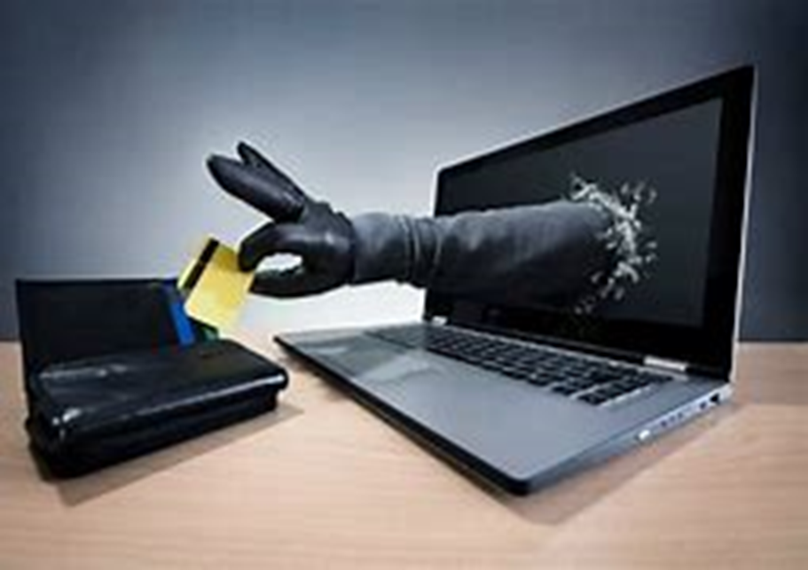
Types of cyber-attacks
Due to the dependency on digital things, the illegal computer activity is growing and changing like any type of crime.

Slide 76
Types of cyber-attacks cont…
There are many methods in which a cyber-attacker can enter and exploit a system. Often, attacks are not technical at all, but rather an exploitation of how humans interact with the system in a flawed and vulnerable way.

Slide 77
Types of cyber-attacks cont…
Selected common types of cyber-attacks.
Denial of service (DoS) attack
Distributed denial of service (DDoS) attack
Phishing attack
Spear phishing attack
Malware
Man in the middle (MitM) attack
Domain name system (DNS) attack
Structured query language (SQL) injection
Brute force
Social engineering
Let's examine these in greater depth.

Slide 78
Types of cyber-attacks cont…
Selected common types of cyber-attacks.
Denial of service (DoS) attack
A DoS attack is any type of attack that causes a complete or partial system outage.
The means to perform a DoS attack can range from causing a system to crash to making it unreachable or incapable of continuing work due to abnormal levels of forwarded network traffic.
An example of this is a billion laugh attack, in which an XML file references itself, expanding to a considerably larger file.

Slide 79
Types of cyber-attacks cont…
Selected common types of cyber-attacks.
Distributed denial of service (DDoS) attack
A DDoS attack is a DoS attack that comes from more than one source at the same time.
The machines used in such attacks are collectively known as “botnets” and will have previously been infected with malicious software, so they can be remotely controlled by the attacker.

Slide 80
Types of cyber-attacks cont…
Selected common types of cyber-attacks.
Phishing attack
A phishing attack is the practice of sending messages that appear to be from trusted sources with the goal of gaining personal information or influencing users to do something.
It combines social engineering and technical trickery.
Unsuspecting users open the email and may provide protected information or download malware.

Slide 81
Types of cyber-attacks cont…
Selected common types of cyber-attacks.
Spear phishing attack
Spear phishing attacks are a very targeted type of phishing activity.
Attackers take the time to conduct research into targets and create messages that are personal and relevant, and thus likely more effective.

Slide 82
Types of cyber-attacks cont…
Selected common types of cyber-attacks.
Malware
It is any software designed to perform in a detrimental manner to a targeted user without the user's informed consent.
It often triggers secretly when a user runs a program or downloads a file, which can often be unintentional.
Once active, malware can block access to data and programs, steal information, and make systems inoperable.

Slide 83
Types of cyber-attacks cont…
Selected common types of cyber-attacks.
Man in the middle (MitM) attack
A MitM attack occurs when hackers insert themselves in the communications between a client and a server.
This allows hackers to see what’s being sent and received by both sides.

Slide 84
Types of cyber-attacks cont…
Selected common types of cyber-attacks.
Domain name system (DNS) attack
the DNS protocol allows a computer to resolve a domain to an IP address, which allows a user to, for example, reach BMW’s main website by typing “bmw.com” instead of writing an IP address that is hard to remember.
DNS is used almost everywhere. As a core protocol of the internet, lots of attack vectors directly target DNS, including DNS spoofing, domain hijacking, and cache poisoning.

Slide 85
Types of cyber-attacks cont…
Selected common types of cyber-attacks.
Structured query language (SQL) injection
SQL allows users to query databases.
SQL injection is the placement of malicious code in SQL queries, usually via web page input. A successful attack allows common commands to be run. This can include deleting the database itself.
SQL injection is one of the most common web hacking techniques.

Slide 86
Types of cyber-attacks cont…
Selected common types of cyber-attacks.
Brute force.
It is a type of attack which uses a trial and error method. This attack generates a large number of guesses and validates them to obtain actual data like user password and personal identification number.
This attack may be used by criminals to crack encrypted data, or by security, analysts to test an organization's network security.

Slide 87
Types of cyber-attacks cont…
Selected common types of cyber-attacks.
Social Engineering
There is no technology today that cannot be defeated by social engineering.
Frank Abagnale

Slide 88
Types of cyber-attacks cont…
Selected common types of cyber-attacks.
Social Engineering
social engineering is the use of deception to manipulate individuals into divulging confidential or personal information that could then be used for fraudulent purposes.

Slide 89
Types of cyber-attacks cont…
Selected common types of cyber-attacks.
Social Engineering
Social engineering tactics include:
Authority – people are more likely to comply when instructed by an authority
Intimidation – criminals bully a victim into taking action
Consensus/Social Proof – people will take action if they think that other people like it too

Slide 90
Types of cyber-attacks cont…
Selected common types of cyber-attacks.
Social Engineering
Social engineering tactics include:
Scarcity – people will take action when they think there is a limited quantity
Urgency – people will take action when they think there is a limited time

Slide 91
Types of cyber-attacks cont…
Selected common types of cyber-attacks.
Social Engineering
Social engineering tactics include:
Familiarity/Liking – Criminals build a rapport with the victim to establish a relationship
Trust – Criminals build a trusting relationship with a victim which may require more time to establish.

Slide 92
Types of cyber-attacks cont…
With the increasing number of cybercrimes today, it is good to be aware of cyber-attacks and how one can protect their network.

Slide 93

Threat actor groups.
With the increasing number of cybercrimes today, it is good to be aware of cyber-attacks and how one can protect their network.

Slide 94
Threat actor groups cont…
Cybersecurity professionals must be aware of the different types of threat actor groups, or cyber attacker groups.
These are diverse groups and they vary substantially in motivation, resources, and techniques.

Slide 95
Threat actor groups cont…
Let's review and compare the five types of cyber attacker groups.
Script kiddie
Hacktivist
Cyber Criminals
Nation state hacker
Insider Threats

Slide 96
Threat actor groups cont…
SCRIPT KIDDIE.
Script kiddie
The term "script kiddie" refers to someone who uses programs, frequently basic hacking tools, without truly understanding what is going on behind the scenes.
They may display a basic understanding of networking and programming, but lack technical skills as well as patience or strategic intent.

Slide 97
Threat actor groups cont…
SCRIPT KIDDIE.
Profile of a script kiddie
Who are they? | What is their objective?
Self-taught individuals, typically teenagers | Seek reputation enhancement or attack for fun
What resource do they have? | How do you protect against them?
Little funding, little or no technical expertise and assistance, may use free tools written by others | Ensure patching schedule is effective and basic perimeter defenses are up to date

Slide 98
Threat actor groups cont…
HACKTIVIST
Hacktivist
Hacktivist is a term which combines "hacker" and "activist".
Hacktivists seek a political or economic change and will use hacking to achieve it.

Slide 99
Threat actor groups cont…
HACKTIVIST
Profile of a hacktivist
Who are they? | What is their objective?
Driven idealists forming loose coalitions | Want to bring about a change
What resource do they have? | How do you protect against them?
Operate at scale with varying tools and biggest attribute is size | Ensure defenses can cope with an extended disruptive attack

Slide 100
Threat actor groups cont…
CYBER CRIMINALS
Cyber Criminals
Cybercriminals are individual or group of people who use technology to commit cybercrime with the intention of stealing sensitive company information or personal data and generating profits.

Slide 101
Threat actor groups cont…
CYBER CRIMINALS
Profile of a Cyber Criminals
Who are they? | What is their objective?
Groups of people in national and international teams | Driven by financial motivations
What resource do they have? | How do you protect against them?
Broad range of tools and equipment, bought and traded on the dark web | Need to have a fully trained workforce with protections around critical assets and back-ups

Slide 102
Threat actor groups cont…
STATE SPONSORED
Nation state hacker
Many military organizations around the world now consider cyberspace a fifth sphere of conflict alongside sea, land, air, and space.
Many nations have demonstrated the ability to project power across national borders to a great and expanding variety of consequences.

Slide 103
Threat actor groups cont…
STATE SPONSORED
Profile of a Nation state hacker
Who are they? | What is their objective?
Highly trained and educated specialists | Follow strategic, multi-year plans on a wide range of issues
What resource do they have? | How do you protect against them?
Very large budgets, cutting-edge tooling, and leading-edge research | Incredibly difficult; need fully coordinated defenses around every aspect of the organization

Slide 104
Threat actor groups cont…
INSIDER THREATS
Insider threats
The insider refers to a member within an organization that either intentionally or otherwise acts against it.

Slide 105
Threat actor groups cont…
INSIDER THREATS
Insider threats
Insider threats can be categorized as:
Malicious
Accidental
Negligent

Slide 106
Threat actor groups cont…
INSIDER THREATS
Insider threats
Insider threats can be categorized as:
Malicious
Malicious threats are attempts by an insider to access and potentially harm an organization's data, systems or IT infrastructure.
These insider threats are often attributed to dissatisfied employees or ex-employees who believe that the organization was doing something wrong with them in some way, and they feel justified in seeking revenge.

Slide 107
Threat actor groups cont…
INSIDER THREATS
Insider threats
Insider threats can be categorized as:
Accidental
Accidental threats are threats which are accidently done by insider employees.
An employee might accidentally delete an important file or inadvertently share confidential data with a business partner going beyond company's policy or legal requirements.

Slide 108
Threat actor groups cont…
INSIDER THREATS
Insider threats
Insider threats can be categorized as:
Negligent
These are the threats in which employees try to avoid the policies of an organization put in place to protect endpoints and valuable data.
For example, if the organization have strict policies for external file sharing, employees might try to share work on public cloud applications so that they can work at home.

Slide 109
Threat actor groups cont…
INSIDER THREATS
Profile of insider threats.
Who are they? | What is their objective?
Staff members who work against an organization's own interests, either deliberately or accidentally | Seek revenge or have financial motives
What resource do they have? | How do you protect against them?
No budget or resources required; use granted access | Monitor staff carefully and ensure organization's culture is effective to prevent issues

Slide 110
Threat actor groups cont…
Sometimes these descriptions of the types of cyber attackers are not always precise.
In operations, hacktivists might recruit script kiddies and nation state hackers might recruit criminal gangs.
Some cyber attackers will disguise their work to appear less advanced than they are.
These facts can make it difficult to attribute threats to the correct party.

Slide 111

CYBERCRIME PREVENTION.
“Rather than fearing or ignoring cyber-attacks, do ensure your cyber resilience to them”.
Stephane Nappo

Slide 112
CYBERCRIME PREVENTION cont…
An organization can take a number of steps to defend against various attacks.
This steps include:
Configure firewalls
Encrypting traffic, providing cryptographic authentication, and including a time stamp with each portion of the message
Antivirus Program - is a computer program used to prevent, detect, and remove malware.

Slide 113
CYBERCRIME PREVENTION cont…
An organization can take a number of steps to defend against various attacks.
This steps include:
Ensuring patches and upgrades are current, distribute the workload across server systems, and block external Internet Control Message Protocol (ICMP) packets at the border.
Changing the default configuration settings.

Slide 114
CYBERCRIME PREVENTION cont…
An organization can take a number of steps to defend against various attacks.
This steps include:
Promote awareness of social engineering tactics and properly educate employees on prevention measures
Establish policies and educate employees about those policies.

Slide 115
CYBERCRIME PREVENTION cont…
An organization can take a number of steps to defend against various attacks.
This steps include:
Enacting new laws to discourage cyber-attacks and data breaches
Sharing cyber intelligence information.

Slide 116
CYBERCRIME PREVENTION cont…
Preventing cybercrime boils down to the key elements which will capture even the examples that we have mentioned.

Slide 117

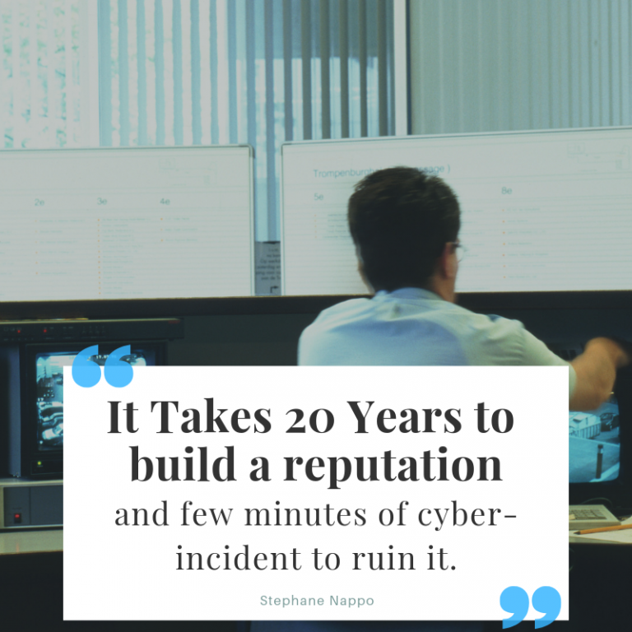

Slide 118
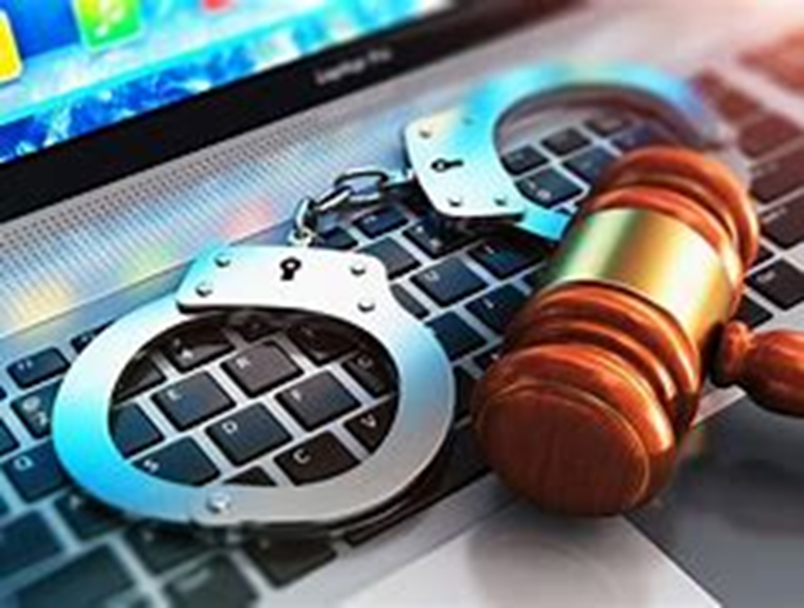
CYBER ETHICS AND LAWS.
"Do not do something in cyberspace that you would consider wrong or illegal in everyday life."

Slide 119
CYBER ETHICS AND LAWS cont…
What’s the objective of cyber ethics and laws.
To provide a comprehensive framework of societal and commerce enabling laws which encompass aspects concerning security of information and network integrity and reliability

Slide 120
CYBER ETHICS AND LAWS cont…
They can be categorized as follows;
Cyber Security Standards.
Cyber Security laws.
Cyber Security Policies.

Slide 121
CYBER ETHICS AND LAWS cont…
CYBER SECURITY STANDARDS
They can be categorized as follows;
CYBER SECURITY STANDARDS.
Cyber Security standard may be defined as the set of rules that an organization has to comply in order to gain right for some particular things.

Slide 122
CYBER ETHICS AND LAWS cont…
CYBER SECURITY STANDARDS
Cont...
CYBER SECURITY STANDARDS.
The standards consist of some of the basic rules that the organization is supposed to obey in order to maintain compliance with any of the cybersecurity standards.

Slide 123
CYBER ETHICS AND LAWS cont…
CYBER SECURITY STANDARDS
Cont...
CYBER SECURITY STANDARDS.
Based on the requirement of the enterprise or the organization, there are several different standards that they can opt for to bring special capabilities.
In some places, the government has its own standard that anyone has to obey who is willing to work for the government.

Slide 124
CYBER ETHICS AND LAWS cont…
CYBER SECURITY STANDARDS
Cont...
CYBER SECURITY STANDARDS.
There are several cybersecurity standards out there that are supposed to protect the system and its users in various ways. Based on what kind of data has to be protected, there are different standards.

Slide 125
CYBER ETHICS AND LAWS cont…
CYBER SECURITY STANDARDS
Cont...
They can be categorized as follows;
CYBER SECURITY STANDARDS.
Some of the common and important standards:
ISO 27000 SERIES
PCI DSS
HIPAA
FINRA
GDPR

Slide 126
CYBER ETHICS AND LAWS cont…
CYBER SECURITY STANDARDS.
ISO 27000 SERIES
This is one of the common standards that adhere to the organization to implement an Information security management system.

Slide 127
CYBER ETHICS AND LAWS cont…
CYBER SECURITY STANDARDS.
ISO 27000 SERIES
It is comprised of the set of procedures that states the rules and requirements which has to be satisfied in order to get the organization certified with this standard.

Slide 128
CYBER ETHICS AND LAWS cont…
CYBER SECURITY STANDARDS.
ISO 27000 SERIES
As per this standard, the organization is supposed to keep all the technology up to date, the servers should exist without vulnerabilities and the organization has to be audited after the specified interval to remain compiled to this standard.

Slide 129
CYBER ETHICS AND LAWS cont…
CYBER SECURITY STANDARDS.
PCI DSS
PCI DSS stands for Payment Card Industry Data Security Standard.
This can be considered as the standard that has to be opted by the organization that accepts payment through their gateway.

Slide 130
CYBER ETHICS AND LAWS cont…
CYBER SECURITY STANDARDS.
PCI DSS
As per this compliance, the technologies used by the organization should be up-to-date and their system should continuously undergo the security assessment to ensure that it is not having any severe vulnerability.
This standard was developed by the cluster of card brands(American Express, Visa, MasterCard, JCB, and Discover).

Slide 131
CYBER ETHICS AND LAWS cont…
CYBER SECURITY STANDARDS.
HIPAA
HIPAA stands for Health Insurance Portability and Accountability Act.
It is the standard that the hospitals are supposed to follow to ensure that their patient’s data are fully protected and cannot be leaked anyway.

Slide 132
CYBER ETHICS AND LAWS cont…
CYBER SECURITY STANDARDS.
HIPAA
In order to comply with this standard, the hospital must have a strong network security team who takes care of all the security incidents, their quarterly security reports should be healthy, all the transaction has to be done in encrypted mode and so on.

Slide 133
CYBER ETHICS AND LAWS cont…
CYBER SECURITY STANDARDS.
HIPAA
This standard ensures that the critical health-related information of the patient will remain secure so that the patient can feel safe about their health.

Slide 134
CYBER ETHICS AND LAWS cont…
CYBER SECURITY STANDARDS.
FINRA
FINRA stands for Financial Industry Regulatory Authority.
This standard is all about making things secure for the financial bodies that handle the funds or aggressively engaged in financial transactions.

Slide 135
CYBER ETHICS AND LAWS cont…
CYBER SECURITY STANDARDS.
FINRA
In this standard, the system is supposed to be highly secure and to comply with this standard, various measures have to be considered in terms of data security and the user’s data protection.

Slide 136
CYBER ETHICS AND LAWS cont…
CYBER SECURITY STANDARDS.
CYBER SECURITY STANDARDS.
Some of the common and important standards:
GDPR
GDPR stands for General Data Protection Regulation.
It is a standard defined by the European government which is concerned about the data protection of all the users.

Slide 137
CYBER ETHICS AND LAWS cont…
CYBER SECURITY STANDARDS.
GDPR
In this standard, the body that has to manage the compliance to make sure that the user’s data is secure and cannot be accessed without proper authorization.
This standard mainly focuses on the safety of the user’s data so that they can feel safe while sharing it with any of the organizations that are complying with the General Data Protection Regulation.

Slide 138
CYBER LAWS.
Cyber law is otherwise called Digital Law or Internet Law.
Cyber law is the zone of law that manages the Internet’s relationship to technology, innovative and electronic components, including computers, programming, equipment, data frameworks and Information System.

Slide 139
CYBER ETHICS AND LAWS cont…
Cyber Law
CYBER LAWS
Cyber law is the area of law that deals with the Internet's relationship to technological and electronic elements, including computers, software, hardware and information systems.
Cyber law is also known as Cyber Law or Internet Law.

Slide 140
CYBER ETHICS AND LAWS cont…
Cyber Law
CYBER LAWS
Cyber laws prevent or reduce large scale damage from cybercriminal activities by protecting information access, privacy, communications, intellectual property (IP) and freedom of speech related to the use of the Internet, websites, email, computers, cell phones, software and hardware, such as data storage devices.

Slide 141
CYBER ETHICS AND LAWS cont…
Cyber Law and Intellectual Property
Cyber Law and Intellectual Property
An important part of cyber law is intellectual property.
Intellectual property can include areas like inventions, literature, music, and businesses. It now includes digital items that are offered over the internet.

Slide 142
CYBER ETHICS AND LAWS cont…
Cyber Law and Intellectual Property
Cyber Law and Intellectual Property
It is a right that allow creators, or owners of patents, trademarks or copyrighted works to benefit from their own plans, ideas, or other intangible assets or investment in a creation.

Slide 143
CYBER ETHICS AND LAWS cont…
They can be categorized as follows;
CYBER LAWS
Cyber Law and Intellectual Property
IP rights related to cyber law generally fall into the following categories:
Copyright
Patents
Trademarks/Service Marks
Trade Secrets
Domain Disputes
Contracts.
Privacy
Data Retention.

Slide 144
CYBER ETHICS AND LAWS cont…
Cyber Law and Intellectual Property
Copyright.
Copyrights provide protection to almost any piece of IP you can transmit over the internet. This can include books, music, movies, blogs, and much more.

Slide 145
CYBER ETHICS AND LAWS cont…
Cyber Law and Intellectual Property
Patents.
Patents are generally used to protect an invention. These are used on the internet for two main reasons.
The first is for new software.
The second is for new online business methods.

Slide 146
CYBER ETHICS AND LAWS cont…
CYBER LAWS
Trademarks/Service Marks.
Trademarks and service marks are used the same online as they are in the real world.

Slide 147
CYBER ETHICS AND LAWS cont…
CYBER LAWS
Domain Disputes.
This is related to trademarks. Specifically, domain disputes are about who owns a web address. For instance, the person who runs a website may not be the person who owns it.
Additionally, because domains are cheap, some people buy multiple domains hoping for a big payday.

Slide 148
CYBER ETHICS AND LAWS cont…
CYBER LAWS
Contracts.
Most people don't think contracts apply online. This is not the case.
For example, when you register for a website, you usually have to agree to terms of service. This is a contract.

Slide 149
CYBER ETHICS AND LAWS cont…
CYBER LAWS
Privacy.
Online businesses are required to protect their customer's privacy.
The specific law can depend on your industry. These laws become more important as more and more information is transmitted over the internet.

Slide 150
CYBER ETHICS AND LAWS cont…
CYBER LAWS
Data Retention.
Handling data is a primary concern in the internet age. An area where this has become a big issue is in terms of litigation.
In lawsuits, it is now common to request electronic records and physical records. However, there are no current laws that require keeping electronic records forever.

Slide 151
CYBER ETHICS AND LAWS cont…
CYBER SECURITY POLICIES.
CYBER SECURITY POLICIES
Security policies are a formal set of rules which is issued by an organization to ensure that the user who are authorized to access company technology and information assets comply with rules and guidelines related to the security of information.

Slide 152
CYBER ETHICS AND LAWS cont…
CYBER SECURITY POLICIES.
CYBER SECURITY POLICIES
It is a written document in the organization which is responsible for how to protect the organizations from threats and how to handles them when they will occur.

Slide 153
CYBER ETHICS AND LAWS cont…
CYBER SECURITY POLICIES.
CYBER SECURITY POLICIES
A security policy also considered to be a "living document" which means that the document is never finished, but it is continuously updated as requirements of the technology and employee changes.

Slide 154
CYBER ETHICS AND LAWS cont…
TYPES OF CYBER SECURITY POLICIES.
They can be categorized as follows;
CYBER SECURITY POLICIES
TYPES OF CYBER SECURITY POLICIES.
Virus and Spyware Protection policy
Firewall Policy
Intrusion Prevention policy
Live Update policy
Application and Device Control.
Exceptions policy.
Host Integrity policy

Slide 155
CYBER ETHICS AND LAWS cont…
TYPES OF CYBER SECURITY POLICIES.
Virus and Spyware Protection policy
It blocks the unauthorized users from accessing the systems and networks that connect to the Internet.
It detects the attacks by cybercriminals.
It removes the unwanted sources of network traffic.

Slide 156
CYBER ETHICS AND LAWS cont…
TYPES OF CYBER SECURITY POLICIES.
Firewall Policy
It helps to detect, removes, and repairs the side effects of viruses and security risks by using signatures.
It helps to detect the threats in the files which the users try to download by using reputation data from Download Insight.

Slide 157
CYBER ETHICS AND LAWS cont…
TYPES OF CYBER SECURITY POLICIES.
Intrusion Prevention policy
This policy automatically detects and blocks the network attacks and browser attacks. It also protects applications from vulnerabilities.
It checks the contents of one or more data packages and detects malware which is coming through legal ways.

Slide 158
CYBER ETHICS AND LAWS cont…
TYPES OF CYBER SECURITY POLICIES.
Live Update policy.
This policy can be categorized into two types one is Live Update Content policy, and another is Live Update Setting Policy.

Slide 159
CYBER ETHICS AND LAWS cont…
TYPES OF CYBER SECURITY POLICIES.
HOST INTEGRITY
This policy provides the ability to exclude applications and processes from detection by the virus and spyware scans.

Slide 160
CYBER ETHICS AND LAWS cont…
TYPES OF CYBER SECURITY POLICIES.
Exceptions policy
This policy provides the ability to exclude applications and processes from detection by the virus and spyware scans.

Slide 161
CYBER ETHICS AND LAWS cont…
Cyber Law Trends
Cyber Law Trends
Cyber law is increasing in importance every single year. This is because cybercrime is increasing. To fight these crimes, there have been recent trends in cyber law.

Slide 162
CYBER ETHICS AND LAWS cont…
Cyber Law Trends
Cyber Law Trends
These trends include the following:
New and more stringent regulations.
Reinforcing current laws.
Increased awareness of privacy issues.
Cloud computing.
How virtual currency might be vulnerable to crime.
Usage of data analytics.

Slide 163
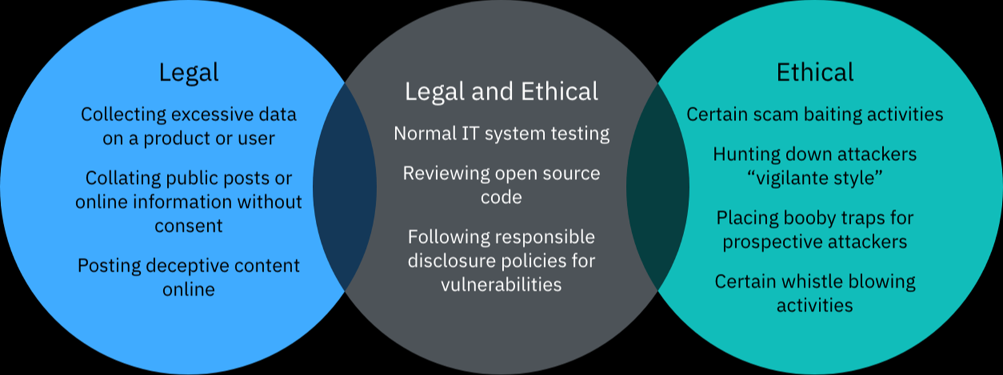
CYBER ETHICS AND LAWS cont…
Comparison of laws/ legality and ethics

Slide 164
SUMMARY.
Cyber security entails the consideration of process and technology for efficiency, for this to be realized fully people must be wholly involved in enforcing confidentiality, integrity and availability of cyber resources and constantly improving on them.

Slide 166

Thankyou.

